Slide 1
Agenda
9:00 – 9:50 | Introduction to MVC
10:00 – 10:50 | Data
11:00 – 11:45 | Labs
11:45 – 12:45 | Lunch
12:45 – 13:30 | Forms and validation
13:45 – 14:45 | Advanced
14:45 – 15:30 | Labs

Slide 2
Recap
Remember the ASP.NET MVC Values?
Easy to build, develop and maintain web applications
Simple to extend and customize
Encourages a clean and robust architecture
In Part 1 we
Understood ASP.NET MVC
Understood Entity Framework
Using Entity Framework in “Plan My Night”
Notes:
Estimated Time: 2 mins
Welcome back to the second part of this 3-part series where we look at how you can build a rich web application with the Microsoft Web Platform. We all remember the ASP.NET MVC Values…
In the last part, we explored the fundamentals of ASP.NET MVC and how it provides a separation of concerns and create clean and simple testable code.
We also understood how the Entity Framework can manage the data-tier of our applications with ease.

Slide 3
Doing more with Views
HTML Helpers
Templated Helpers
ViewModels
Validation
Notes:
Estimated Time: 3 minutes
In this session we are going to be modifying the Plan My Night Application to include HTML Helpers, Templated Helpers and Validation and how these features will make it easier to enhance our web applications.

Slide 4
Have you ever been asked to make a site-wide change that seemed like it should be simple… but wasn’t?
Notes:
Estimated Time: 2 mins
There has probably been a time when your boss has wanted you to make a change to your web application. Let’s imagine he or she asks you to add a widget to a text box that shows the date – making it easier to select a valid date field. The problem is that this change isn’t just in one place – it’s everywhere you display the date. Of course your boss doesn’t appreciate that you are going to have to make changes across the site, modifying each text box where a date is shown!
Over the next few slides, we’ll start to look at some of the ways you can let ASP.NET MVC help you work smarter, not harder.

Slide 5
String-based HTML Helpers
<%= Html.TextBox("ActivityType") %>
<input type="text"
name="ActivityType"
value=“Restaurant" />
Notes:
Estimated Time: 2 min
Let’s start off with a simple example…
HTML Helpers save us time by emitting HTML for items of data on our behalf. However, in ASP.NET MVC 1, HTML Helpers were string-based which meant the code was more brittle. If you made changes to the name of your properties in the database, your HTML Helpers would not flag any issues until runtime. This meant your code was harder to maintain.
There have been some changes in ASP.NET MVC 2 that make HTML Helpers even better to use….

Slide 6
Strongly-Typed HTML Helpers
<%: Html.TextBoxFor(m => m.ActivityType) %>
<input type="text"
name="ActivityType"
value="Restaurant" />
Notes:
Estimated Time: 3 mins
In ASP.NET MVC 2 we now provide the support for strongly-typed HTML helpers which make our code easier to maintain and use. If we now made alterations to our model we would know about changes we needed to make in our views at compile-time. Also, we get support in Visual Studio for IntelliSense on the model which makes coding faster.

Slide 7
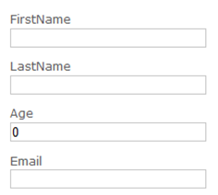
Display and Editor Scaffolding
<%: Html.EditorForModel() %>
Notes:
Estimated Time: 2 mins
There are also HTML helpers that provide a lot of the scaffolding for representing the model in the view automatically. For instance, the display and editor for model will render a complete UI using your model as a basis. In this example we’re using a simple model for a user and we are using the EditorForModel helper to render the input boxes for us.

Slide 8

Templated Helpers
Built-in templates:
Text (single & multi-line)
Boolean (2- and 3-state)
Decimal
Password
Hidden
HTML
E-mail address
URL
Collection
Complex object
Making it easy
HTML Helpers
Display and Editor Scaffolding
Allowing you to extend
Built-in Templates
Customize Templates
Controller, Site-wide
Notes:
Estimated Time: 3 mins
Let’s summarize what we’ve just seen. The HTML templates and scaffolding make development easy. Even better, they are using built-in templates for rendering different DataTypes which can be easily extended and customized for your specific purpose. This means that the scenario we talked about before with the customized date picker would be easy to implement since you would simply change the DateTime template to override the default behavior. We’ll explore this more in a demo later on.

Slide 9
Built-in Display Templates
DisplayForModel()
Boolean – disabled checkbox
Collection – iterate and display
Decimal – encoded text (with formatting)
EmailAddress – auto-linked (with mailto:)
HiddenInput – encoded text
Html – unencoded text
Object – show all simple properties
String, Text – encoded text
Url – auto-linked
Notes:
Estimated Time: 2 mins
We made a big effort with ASP.NET MVC 2 to make common scenarios easier for web developers. Some of the new Display Templates included in ASP.NET MVC 2 are…

Slide 10
Built-in Editor Templates
EditorForModel()
Boolean – checkbox or 3-state drop-down
Collection – iterate and show editor
Decimal – text box (with formatting)
HiddenInput – hidden input
MultilineText – text area
Object – edit all simple properties
Password – text box (password)
String, Text – text box
Notes:
Estimated Time: 2 mins
On the editor side, we provide these Editor Templates out of the box – for 90% of the scenarios out there, we’ve got you covered.

Slide 11

Data Annotations
Notes:
Estimated Time: 2 mins
Once you have models defined in your application you can annotate them with metadata in order to ensure they are rendered and behave in a reliable way throughout the entire app.
In this example we define how this property EmailAddress should be displayed to the user. This information is used by HTML Helpers when displaying the label for the property and ensures that the DisplayName is used for instead of the default property name. We’ve also defined the data type as EmailAddress which means a specific template will be used to render a link with “mailto” already applied.

Slide 12
Data Annotations
[HiddenInput]
[UIHint]
[DataType]
[ReadOnly]
[DisplayFormat]
[ScaffoldColumn]
Notes:
Estimated Time: 2 mins
There are a number of DataAnnotations that you will find useful when building your applications. These include:
HiddenInputAttribute
Applying this attribute will generate a hidden input when editing this model. By default, it will also hide all the surrounding HTML, unless you set the DisplayValue flag to be true; in this case, it will generate both a displayed value (with its surrounding HTML) and the hidden input. In addition to setting HideSurroundHtml, it also sets a TemplateHint of “HiddenInput” (which can be overridden with [UIHint])
UIHintAttribute
This will set the TemplateHint property with the name of the UI hint. We first look for a PresentationLayer type of “MVC”, and if there isn’t one, look for an empty or null PresentationLayer.
DataTypeAttribute
This will set the DataTypeName property. You can use this provide custom validation logic that is associated with a data type that you define.
ReadOnlyAttribute
This will set the IsReadOnly property. Note that because we use Type descriptors, any property without a public setter will have the [ReadOnly] attribute automatically.
DisplayFormatAttribute
Setting NullDisplayText on this attribute sets NullDisplayText on model metadata. Setting DataFormatString will set DisplayFormatString on model metadata; if ApplyFormatInEditMode is set to true, then it will also set the EditFormatString on model metadata. Setting ConvertEmptyStringToNull on the attribute will set ConvertEmptyStringToNull on model metadata.
ScaffoldColumnAttribute
This will set both the ShowForDisplay and ShowForEdit properties.
DisplayNameAttribute
This will set the DisplayName property. You’ll use this to override the property names (which often come from database columns with ugly names) so they look presentable in field labels and validation messages.

Slide 13
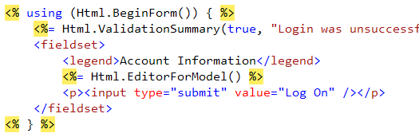
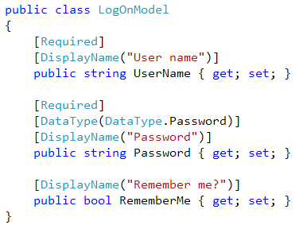
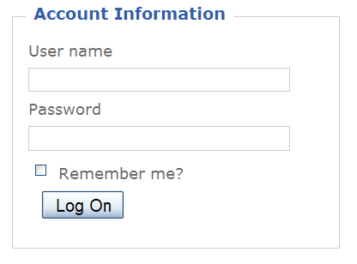
Auto-Scaffolding + DataAnnotations
+
=
Notes:
Estimated Time: 2 mins
When you combine the Templated Helpers and scaffolding with a data model that can be extended using metadata, the effect can be very powerful. In this example we have an EditorForModel which is responsible for rendering the LogonModel. Using the DataAnnotations on the model we can easily manipulate the default behavior of the Scaffolding and change what is rendered – from labels through to the input element.

Slide 14
Using HTML helpers in plan my night
Demo
Notes:
Crib Notes – 003a - Demo Script for HTML Helpers
Estimated Time: 25 mins
Creating a strongly-typed view for editing activities (1m)
Create Activities / Edit action method
Use this code: var activity = this.repository.Retrieve(id);
Create view (strongly typed to Activity, using Edit template)
Show HTML helpers
Show inherits statement
Add ActionLink: <%: Html.ActionLink(“Edit”, “Edit”, “Activities”, new { id = activity.Id, }, null) %>
Run app and show off
Add wrapper HTML at top of Content block
<div class="panel searchResults"> <h2>Edit</h2> <div class="items">
Close div’s
Show Html.EditorForModel()
Demonstrate - same form
Back it out so we can customize
Remove fields except from:
Phone Number
Name
State
ActivityTypeId
DateOpenedId
DropDowns
Show SearchFormViewModel
Create EditActivityViewModel
Add Activity property named Activity
Add SearchFormViewModel property named DropDownOptions
Change Edit view to inherit EditActivityViewModel
Fix broken references in page
Html.DropDownFor on ActivityType and State
Run the application
Templates
Create template for String
EditorFor w/ PhoneNumber
DataAnnotations
Create buddy class
[DisplayName(“Phone Number”)]

Slide 15
What did we see in the demo?
Quick and easy to build apps
Templated Helpers
HTML Helpers (expressions and strings)
Display and Editor Scaffolding
Clean and Robust Architecture
ViewModels
Strongly-typed Views
Getting started with DataAnnotations
Simple to extend
Display and Editor Templates
Notes:
Estimated Time: 3 minutes
In this demo we got to see features in ASP.NET MVC 2 and Visual Studio 2010 that make it quick and easier to build applications whilst keeping a clean and robust architecture and allow you to extend the base functionality.

Slide 16
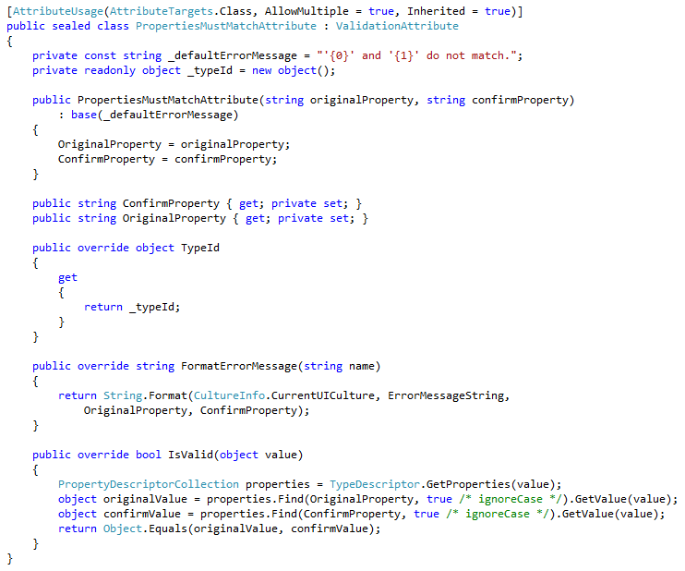
Validation: why so hard?
Notes:
Estimated Time: 2 minutes
In the past, providing strong validation meant writing a lot of code and adding complexity to your web application. When we add client-side validation to the equation it gets even more complicated. Really, we don’t want to be spending time solving problems of validation – we want to be spending more time on the core features of an application.
Realistically, when you are building web apps today, there’s no excuse not to be doing client-side validation – people expect it. Luckily in ASP.NET MVC we have ways to make it very easy to do.

Slide 17
Easy Validation in ASP.NET MVC 2
Apply built-in validators in DataAnnotations to your models
[Required]
[Range]
[RegularExpression]
[StringLength]
Extensible…
Notes:
Estimated Time: 3 mins
ASP.NET MVC 2 gives us built-in validators that solve most of our problems when it comes to validation. They cover common scenarios like Required fields, Range data, Regular Expressions and length of strings. As you would expect, the validators provided out of the box are based upon the a series of classes that you can easily extend for your own scenarios. We’ll discuss this later on after a demo.

Slide 18
Server-side and client-side validation
"Fields" : [{ "FieldName" : "Quantity", "ValidationRules" : [{ "ValidationType" : “range", "ErrorMessage" : "Value is out of range", "ValidationParameters" : {
"minimum" : 1, "maximum" : 50
} }] }]
Notes:
Estimated Time: 3 mins
ASP.NET MVC 2 makes client-side validation much more simple and mirrors the server-side logic and parameters onto the client by emitting JSON which is automatically hooked into javascript libraries which are included for us. The client-side validation is also completely extensible too so you can match up your server-side validators with it’s pair on the client.

Slide 19
Adding Validation to Plan My night
Demo
Notes:
Crib Notes - 003b – Validation
Estimate Time: 25 mins
More DisplayName attributes
Add Required attribute to Name property
Add ErrorMessage
Run it
Create Edit / Post method (use snippet)
Make all fields required
Regular Expression validator for PhoneNumber: @”/d{3}-/d{3}-/d{4}”
Add JS files required for validation to edit
Add EnableClientValidation
Exploring the generated JSON for validation
Exploring a custom validator
Show off end state
Customized CSS for Validation
Search for ParametersMustMatchAttribute using ctrl+, then PMM

Slide 20
What did we see in the demo?
Quick and easy to do validation
Built-in validators
Client-side
Simple to extend
Custom Validator
Modifying CSS
Localization
Notes:
Estimated Time: 3 mins
Let’s recap on what we saw…
Quick and easy to do validation
Aded new properties in our metadata class and then…
Added some built-in validators including Required, Range, and Regular Expression
With one method call, we saw how simple client-side validation is and how there’s no excuse not to do it!
Simple to Extend
As with all parts of MVC we can extend validation too
We explored a custom validator and using the ValidationAttribute
We also customized the CSS to make it look better
Lastly, we added localization using resources and the DataAnnotation value for resource types

Slide 21
Extending Validation
Custom Validation
Server-side with ValidationAttribute
Client-side with ValidatorRegistry
public class PriceAttribute : ValidationAttribute
Sys.Mvc.ValidatorRegistry
.validators["price"]
Notes:
Estimated Time: 3 minutes
In the demo we saw how you can create a custom validator by inheriting from the ValidationAttribute class on the server-side. On the client-side there is work to be done also. Luckily the MVC framework provides a pluggable validation arcitecture on the client too where you can use the ValidatorRegistry to register your custom validator. Using a standard set of methods you are able to have the framework handle the validation for you.

Slide 22

Extending Validation
Pluggable validation providers
Castle, Enterprise Library
Remote Validation
Notes:
Estimated Time: 3 mins
Other areas of validation can be extended too. For example, instead of using the standard validation provider we ship with MVC you can also plug other ones in like Castle or Enterprise Library. They all have different strengths and weaknesess and MVC allows you to choose.
Also, Remote Validation provides you with the ability to do client-side validation on items of data that require information only available on the server side to perform a validation check. A good example of this is when a user registers and you need to ensure they haven’t chosen an existing username – instead of having the form post-back entirely you can do this asynchronously instead and update an area of the page.

Slide 23
Have you ever had trouble maintaining a growing application?
Notes:
Estimated Time: 4 mins
When an application grows in size it inevitably grows in complexity. There is more code, more files, more dependencies etc. Furthermore, when there are multiple individuals and even teams working on the application it becomes challenging to manage who actually owns certain parts of the application. This is a common problem today.

Slide 24
AREAS
Demonstration
Notes:
Estimated Demo Time: 2 mins
This demo has no script – it’s too easy!
Open Plan My Night
Create a new area named Admin
Show the routes registered by admin

Slide 25
What did we see?
Areas in ASP.NET MVC 2 make it easier to maintain and structure an application
Notes:
Estimate Time: 2 minutes
Areas help us to break up applications into separate parts, making it easier to manage the application as it grows in size and complexity. It also helps when there are multiple people working on the project so they can update code in the areas in isolation. When you create a new area it also registers its own routes allowing it to handle requests that are intended for the area without us worrying about setting up the routes ourselves.

Slide 26
Summary
Easy to build, develop and maintain web applications
Simple to extend and customize
Encourages a clean and robust architecture
In Part 3…
jQuery
Deployment
Notes:
Estimated Time: 2 minutes
[Talk to the features]
Easy to build, develop and maintain web applications
HTML Helpers
Templated Helpers
Scaffolding
Simple to extend and customize
Custom Templates
Custom Validation
Validation CSS
Encourages a clean and robust architecture
View Models
Model Metadata

